Slide 1
Nephrotic syndrome
Dr Bashir Admani

Slide 2
Introduction
The nephrotic syndrome is caused by renal diseases that increase the permeability across the glomerular filtration barrier.
Nephrotic range proteinuria — Urinary protein excretion greater than 50 mg/kg per day
Hypoalbuminemia — Serum albumin concentration less than 3 g/dL (30 g/L)
Edema
Hyperlipidemia

Slide 3
Objectives
To understand the pathogenesis of nephrotic syndrome
How to diagnose it
How to manage a patient with nephrotic syndrome

Slide 4
Pathogenesis
Two issues are important in the pathogenesis of nephrotic syndrome: the mechanisms of glomerular injury and proteinuria.
Mechanisms of glomerular injury —
Circulating nonimmune factors in minimal change disease and primary focal glomerulosclerosis.
Circulating immune factors
Mutations in podocyte or slit diaphragm proteins (eg, CD2AP, podocin, and nephrin) in inherited forms of congenital, infantile, or glucocorticoid resistant nephrotic syndrome.

Slide 5
Pathogenesis
Mechanisms of proteinuria —
The proteinuria in glomerular disease is due to increased filtration of macromolecules (such as albumin) across the glomerular capillary wall.
The latter consists of three components:
the fenestrated endothelial cell;
the glomerular basement membrane (GBM);
the epithelial cell foot processes. The pores between the foot processes are closed by a thin membrane called the slit diaphragm

Slide 6
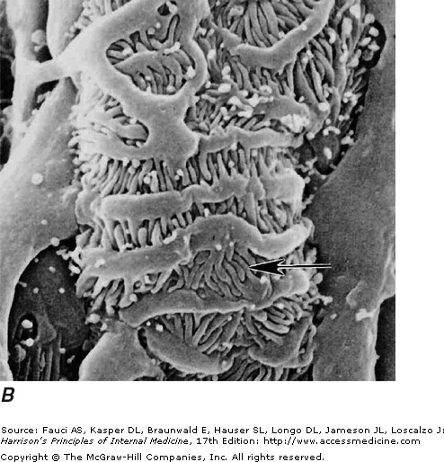
Foot processes extend from epithelial podocytes envelop the outer surface of capillaries and podocytes interconnect to each other by slit pore membranes forming a selective filtration barrier

Slide 7
Classification
Primary
Secondary

Slide 8
SECONDARY CAUSES
Infections: hepatitis, HIV
Malignancies: lymphoma
Drugs: NSAIDS, lithium
Allergies
Haematological: sickle cell disease
Rheumatologic: SLE

Slide 9
Etiology
Minimal change disease (MCD) is the most commonly seen histopathology of childhood nephrosis.
Minimal change disease (MCD) — 77 percent
Membranoproliferative glomerulonephritis (MPGN) — 8 percent
Focal and segmental glomerulosclerosis (FSGS) — 7 percent
Proliferative glomerulonephritis — 2 percent
Mesangial proliferation — 2 percent
Focal and global glomerulosclerosis — 2 percent
Membranous glomerulonephropathy — 2 percent

Slide 10
Clinical manifestations
Primary nephrotic syndrome is more common in younger children, particularly those below six years of age
There is an increased incidence of nephrotic syndrome in family members when compared to the general population
In affected siblings, nephrotic syndrome usually presents at the same age with the same histopathology and outcome

Slide 11
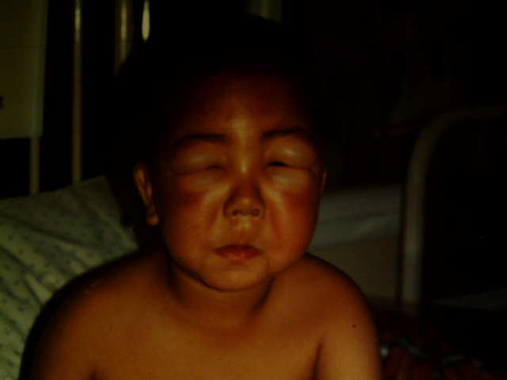
Clinical manifestations

Slide 12
Clinical manifestations
Childhood nephrotic syndrome generally presents with edema
Umbilical or inguinal hernias.
Abdominal pain due to rapid fluid accumulation or peritonitis.
Dyspnea that is most often due to respiratory compromise from pleural effusions or marked ascites.
The likelihood of hypertension varies with the underlying cause of nephrotic syndrome.
Hypertension is common in patients with focal segmental glomerulosclerosis or glomerulonephritis, but is infrequent in MCD.
Gross hematuria is most often seen in patients with glomerulonephritis

Slide 13
Diagnosis
Urinalysis: protein > 3+, +/- blood
Quantitative protein analysis
Total daily excretion >50mg/kg/day
Urine protein :creatinine ratio> 0.2gm/mmol
Serum albumin<30g/dl
Urea/electrolyte/creatinine
Calculate GFR height x coefficient/creatinine
Lipid profile: hypercholesterolemia

Slide 14
Other tests
Blood count
Hepatitis B, HIV, VDRL
Complement studies
Antinuclear antibodies
CXR

Slide 15
Treatment
Prednisolone 2mg/kg/day for 6 weeks then 2 mg/kg alternate days for 6 weeks then taper off over 6 weeks
Most respond to treatment
About 60% relapse
Frequent relapsers are >2 relapse in 6 months
Steroid resistance is proteinuria > 3 + at 4 weeks of treatment

Slide 16
Treatment
Other modalities
Alkylating agents
Cyclophophamide, chlorambucil
Calcineurin inhibitors
Cyclosporin, tacrolimus
MMF, azathioprine
ACE inhibitors

Slide 17
Supportive management
Daily weights
Fluid balance
Antibiotics as long as there is edema
May need diuretics if fluid overloaded(with caution)
May need albumin infusion

Slide 18
Complications
Infection
Anasarca
respiratory distress (eg, pulmonary edema or large pleural effusions),
skin breakdown with an increased risk of cellulitis,
increases the risk of bacterial peritonitis.
Thrombosis
Renal insufficiency
Hypovolemia
Growth

Slide 19
Summary
Diagnosis:
Oedema, proteinuria, hypoalbuminemia, hyperlipidemia
Treatment :
Steroid therapy
Refer at the earliest these patients complicate fast

Slide 20
Question
Child comes with gross edema, which of the following would point towards nephrotic syndrome?
Haematuria, scrotal oedema
Hypertension
High urea and creatinine
Proteinuria, normal renal function
None of the above

